Slide 1

EMBRACE THE POWER OF CYBER THREAT INTELLIGENCE
This slide provides an overview of the importance and benefits of leveraging cyber threat intelligence to enhance an organization's security posture.

Slide 2
THE VITAL ROLE OF CYBER THREAT INTELLIGENCE
Comprehensive Threat Awareness
Gain a holistic understanding of the threat landscape, including emerging trends, actor capabilities, and attack vectors.
Proactive Risk Mitigation
Leverage CTI to identify and address vulnerabilities, minimizing the organization's attack surface and enhancing overall security posture.
Informed Decision-Making
Utilize CTI to make data-driven decisions, allocate resources effectively, and develop tailored security strategies.
Incident Response and Threat Hunting
Integrate CTI into incident response and threat hunting processes, enabling rapid detection, investigation, and remediation of threats.
Collaboration and Information Sharing
Foster CTI-driven collaboration with industry peers, law enforcement, and threat intelligence sharing communities to enhance collective defense.

Slide 3
BENEFITS OF CYBER THREAT INTELLIGENCE
Early Warning
Gain proactive alerts and notifications about emerging cyber threats, enabling your organization to prepare and respond swiftly.
Informed Decision-Making
Make strategic, data-driven decisions to allocate resources and prioritize security measures based on the latest threat intelligence.
Enhanced Threat Visibility
Obtain a comprehensive understanding of the threat landscape, including threat actors, their methods, and their target industries, to strengthen your defenses.
Accelerated Incident Response
Leverage real-time threat data to quickly identify, contain, and mitigate the impact of cyber incidents, reducing the overall cost and recovery time.
Improved Threat Hunting
Actively search for and detect advanced persistent threats (APTs) and other complex attacks by utilizing threat intelligence to guide your investigation and hunting efforts.

Slide 4
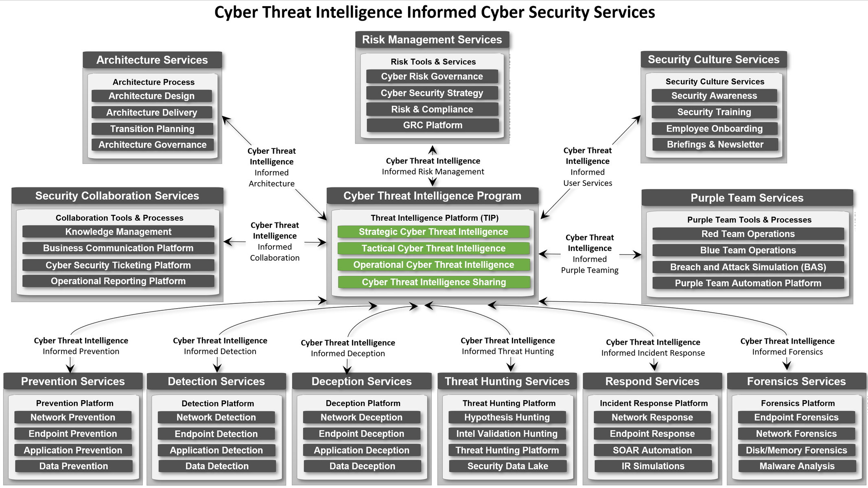

Slide 5
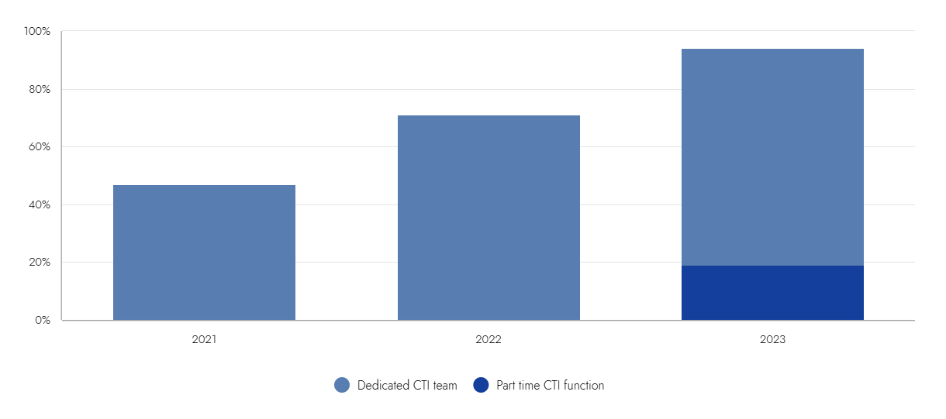
94% OF ORGANIZATIONS HAVE A CTI FUNCTION

Slide 6

BUSINESS AND CTI
Organizations are increasingly recognizing the importance of aligning cybersecurity investments with business outcomes. Threat intelligence is now seen as a strategic asset that provides critical insights for risk management and decision-making.
Cyber threat intelligence (CTI) is never an end in itself. It instead serves a broader mission: to inform, advise, and empower stakeholders within an organization or community. Stakeholder needs drive intelligence requirements. Intelligence requirements are therefore pivotal to a successful CTI capability. -Mandiant

Slide 7
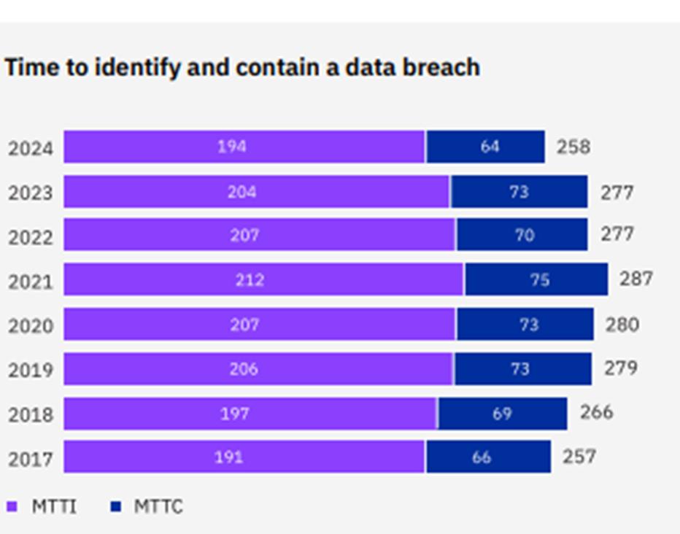
In 2024 Security teams and their tools detected breaches far more often, at 42% of the time, than did benign third parties, at 34%, and attackers themselves, at 24%.
This figure was an improvement over the 2023 report when security teams discovered breaches only one-third of the time.
The change shows security teams were able to speed up detection Gartner research indicates that CTI can reduce identification dwell time

Slide 8
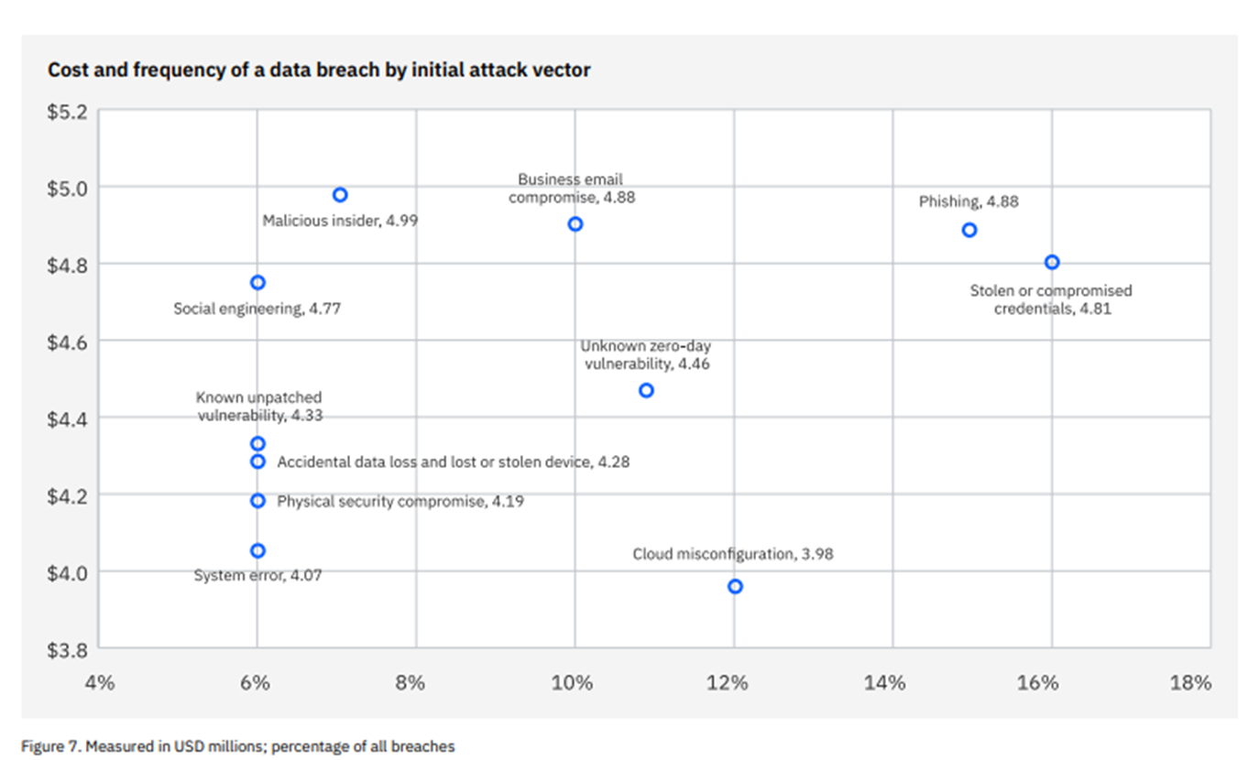
CTI MAKES AN IMPACT
Organizations leveraging threat intelligence see a 30% reduction in the number of security incidents
-Gartner
70% of organizations report improved decision-making in security operations when using threat intelligence
-Forrester

Slide 9




RISK-BASED DECISION MAKING
Prioritizing Threats
Informing Mitigation Strategies
Enhancing Situational Awareness
Measuring and Monitoring Risk
Understanding Risk
Explain how cyber threat intelligence helps organizations identify and assess cybersecurity risks, including the likelihood and potential impact of threats.
Demonstrate how threat intelligence enables organizations to prioritize their security efforts and resource allocation based on the most significant and immediate risks.
Illustrate how threat intelligence supports the development of tailored mitigation strategies, such as implementing appropriate security controls, deploying necessary technologies, and training personnel.
Discuss how threat intelligence enhances an organization's situational awareness, allowing them to anticipate and respond to evolving cyber threats in a timely and effective manner.
Explain how threat intelligence can be used to continuously monitor and measure an organization's risk posture, enabling data-driven decision-making and ongoing risk management.

Slide 10
VULNERABILITY MANAGEMENT
Prioritized Remediation
Contextual Risk Assessment
Proactive Patching
Cyber Threat Intelligence (CTI) helps organizations prioritize vulnerability remediation based on the latest threat actor tactics, techniques, and procedures (TTPs) and active exploits in the wild.
CTI provides valuable context about the severity and likelihood of vulnerabilities being exploited, enabling more accurate risk assessment and decision-making.
By analyzing CTI on emerging threats and exploits, organizations can proactively patch vulnerabilities before they are widely targeted by threat actors.
Targeted Mitigation
Continuous Monitoring
CTI helps security teams implement targeted mitigations and controls to address the specific vulnerabilities and attack vectors most relevant to the organization's threat landscape.
CTI enables ongoing monitoring of the threat environment, allowing organizations to quickly identify and respond to new vulnerabilities and exploit trends.

Slide 11
INCIDENT RESPONSE
Collect and Analyze Threat Data
Enhance Incident Detection
Optimize Incident Response
Leverage threat intelligence to enhance security monitoring and improve the ability to detect and respond to security incidents.
Use threat intelligence to guide and optimize incident response processes, enabling faster and more effective resolution of security incidents.
Gather comprehensive threat intelligence to understand the threat landscape and identify potential attack vectors.
Improve Threat Hunting
Strengthen Threat Modeling
Inform Mitigation Strategies
Employ threat intelligence to proactively hunt for known and emerging threats, staying ahead of the adversaries.
Incorporate threat intelligence into threat modeling activities to better assess and mitigate risks to the organization.
Leverage threat intelligence to develop and implement effective mitigation strategies to address identified vulnerabilities and threats.

Slide 12






SECURITY OPERATIONS
Collect and aggregate data from diverse sources
1
1
2
Analyze threat patterns and indicators of compromise
2
3
Identify emerging threats and potential attack vectors
3
4
Disseminate actionable intelligence to security teams
4
5
Enhance incident response and threat hunting capabilities
5
6
Enable proactive defense and risk mitigation strategies
6

Slide 13
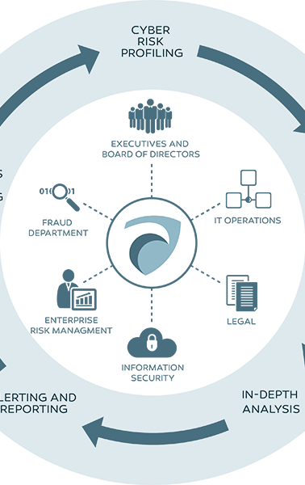
REGULATORY COMPLIANCE
Cyber Threat Intelligence (CTI) can be a powerful tool in helping organizations meet regulatory compliance requirements. By leveraging CTI, businesses can gain critical insights into the threat landscape, understand the tactics, techniques, and procedures (TTPs) used by adversaries, and proactively address potential vulnerabilities and risks. This knowledge can enable organizations to document their security posture, provide justifications for gaps based on prioritization, implement robust controls, and demonstrate effective risk management to regulatory bodies.

Slide 14


THREAT INFORMED
Cyber Threat Intelligence Benefit
Business Impact
Improved detection of security threats
Reduced risk of data breaches and financial losses
Better-informed security strategies and investments
More effective and efficient use of cybersecurity resources
*Gartner, 'How to Use Threat Intelligence to Improve Cybersecurity and Reduce Risk', 2021

Slide 15
PRIORITIZING CYBERSECURITY INVESTMENTS
Data-driven decision-making for security tool acquisition
Focus resources on most relevant and impactful threats
Justify security spending based on actual risk landscape
Optimize security budget allocation for maximum ROI

Slide 16
CYBER THREAT INTELLIGENCE INVESTMENT
1
Reduced Risk of Successful Cyberattacks
2
Improved operational efficiency across security functions
3
Enhanced regulatory compliance posture
4
Long term cost savings through targeted investments

